Slide 1

New Features of Java 21
JEPs in JDK 21 integrated since JDK 17

Slide 2
JEP 422: Linux/RISC-V Port
An instruction set architecture (ISA) defines a CPU's available instructions and how software interacts with it.
RISC-V is an open, royalty-free instruction set architecture (ISA) designed for a wide range of applications, from embedded systems to high-performance computing
New feature involves adapting and optimizing the JDK to run on hardware that utilizes RISC-V architecture and the Linux operating system
The Linux/RISC-V port will only support the RV64GV configuration of RISC-V, which is a general-purpose 64-bit ISA that includes vector instructions

Slide 3
JEP 439: Generational ZGC
The Java garbage collector is an automatic memory management system that identifies and reclaims unused memory, preventing memory leaks and ensuring efficient memory usage in Java applications.
Z Garbage Collector (ZGC) is a low-latency, scalable garbage collector for the Java Virtual Machine (JVM) that's designed to minimize pause times for applications
It was first integrated into JDK 11 as a preview feature then finally in JDK 15 it was production ready

Slide 4
JEP 439: Generational ZGC
Some examples where we may use ZGC instead of the default G1 GC are Online Gaming Servers, Telecommunication Systems, Real-Time Analytics and Dashboards, etc.
New feature looks to improve application performance by extending the Z Garbage Collector (ZGC) to maintain separate generations for young and old objects
To enable Generational ZGC we need to add following flags when running Java application: -XX:ZGC and –XX:ZGenerational
In future non-generational ZGC will be removed and Generational ZGC will be the new default

Slide 5
JEP 451: Prepare to disallow the dynamic Loading of Agents
Java agents are dynamic, runtime components loaded into a Java Virtual Machine (JVM)
They can instrument and modify bytecode of classes at runtime
Java agents are defined in JAR files with an entry point through premain (static) or agentmain (dynamic) methods
Agents are commonly used in tools like profilers and application performance management solutions

Slide 6
JEP 400: UTF-8 by Default
A charset governs the conversion between raw bytes and the 16-bit char values of the Java programming language
If a charset argument is not passed, then standard Java APIs typically use the default charset
The JDK chooses the default charset at startup based upon the run-time environment: the operating system, the user's locale, and other factors
Specify UTF-8 as the default charset of the standard Java APIs
With this change, APIs that depend upon the default charset will behave consistently across all implementations, operating systems, locales, and configurations

Slide 7
JEP 416: Reimplement Core Reflection with Method Handles
Reimplemented java.lang.reflect.Method, Constructor, and Field on top of java.lang.invoke method handles
Functionality remains completely unchanged
Changes are made mostly to support upcoming features and easier maintaining
Performance wise there shouldn’t be any noticeable change

Slide 8
JEP 413: Code Snippets in Java API Documentation
Introduces @snippet tag for JavaDoc's Standard Doclet to simplify the inclusion of example source code in API documentation
Enables modern styling, such as syntax highlighting, as well as the automatic linkage of names to declarations
Enables better IDE support for creating and editing snippets
Supports both inline code snippets and external snippets that we write on separate file

Slide 9
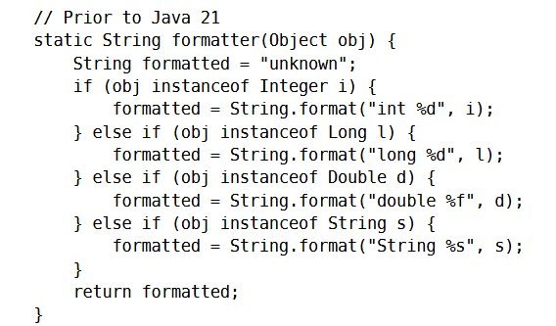
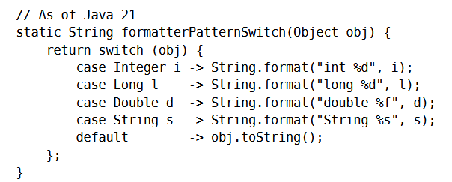
JEP 441: Pattern Matching for switch
Enhances the Java programming language with pattern matching for switch expressions and statements
Extending pattern matching to allows an expression to be tested against a number of patterns

Slide 10
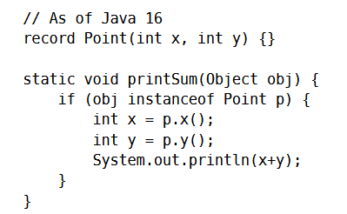
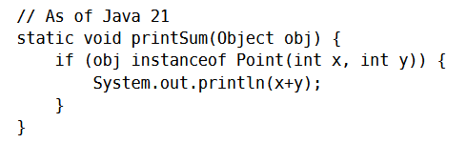
JEP 440: Record Patterns
Enhance the Java programming language with record patterns to deconstruct record values
Record patterns and type patterns can be nested to enable a powerful, declarative, and composable form of data navigation and processing

Slide 11

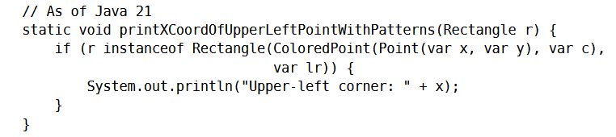
JEP 440: Record Patterns
We can also nest record patterns

Slide 12
JEP 431: Sequenced Collections
Introduce new interfaces to represent collections with a defined encounter order
Each such collection has a well-defined first element, second element, and so forth, up to the last element
It also provides uniform APIs for accessing its first and last elements, and for processing its elements in reverse order

Slide 13
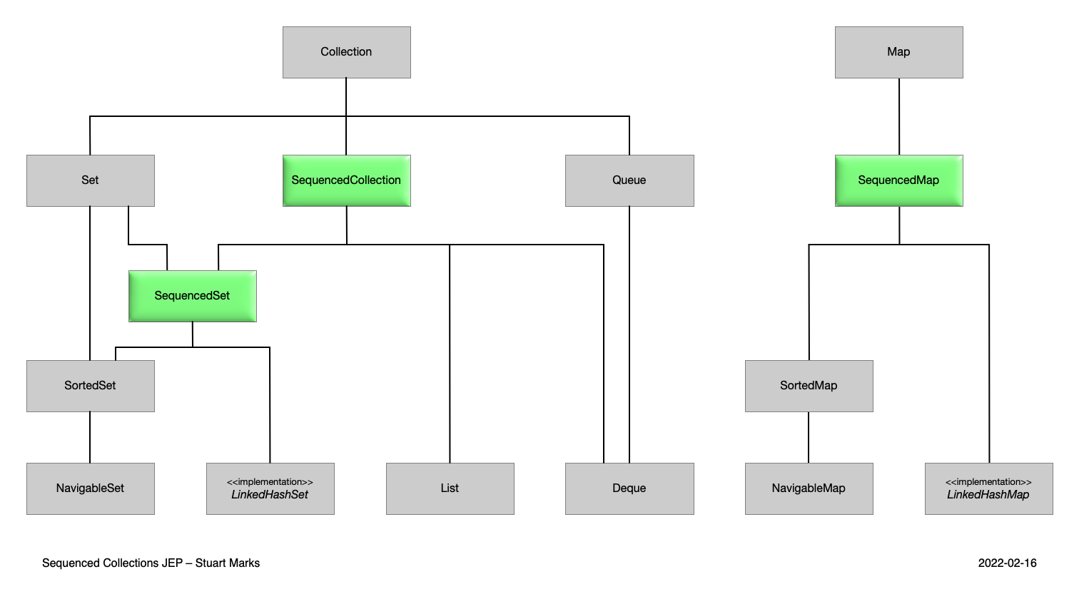
JEP 431: Sequenced Collections

Slide 14
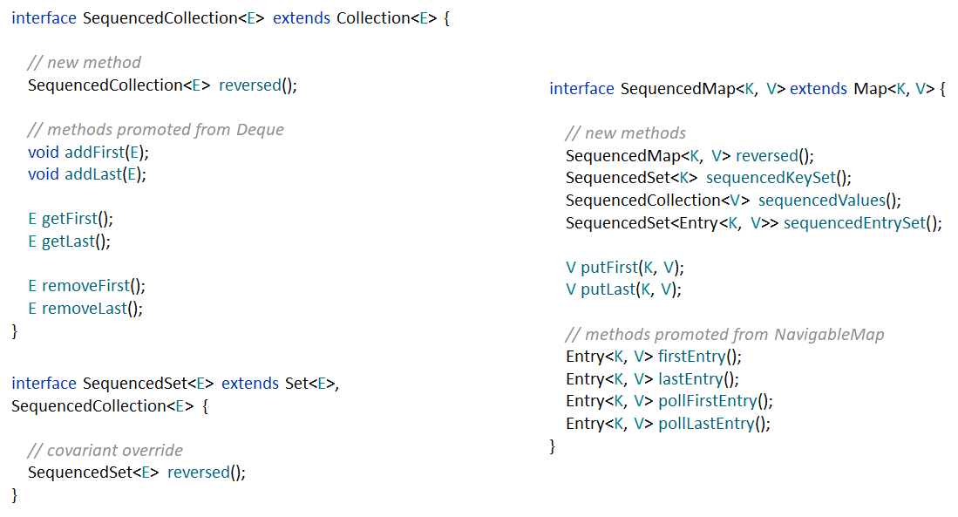
JEP 431: Sequenced Collections

Slide 15
JEP 444: Virtual Threads
Virtual threads are lightweight threads that dramatically reduce the effort of writing, maintaining, and observing high-throughput concurrent applications
Virtual Threads minimize context switching, reducing the performance overhead associated with traditional threads
Java Virtual Threads enable greater parallelism in Java applications, especially when dealing with I/O-bound workloads
Developers can write simpler and more straightforward code for concurrency tasks, as they don't need to worry about explicit thread management

Slide 16
JEP 444: Virtual Threads
They coexist with native threads in the same process, allowing for better resource utilization and scalability
Existing Java applications can migrate to using Virtual Threads with relatively minimal code changes, as they are part of the standard Java platform
Virtual Threads can enhance the scalability of Java applications, particularly in scenarios where handling many concurrent tasks is critical

